Slide 1
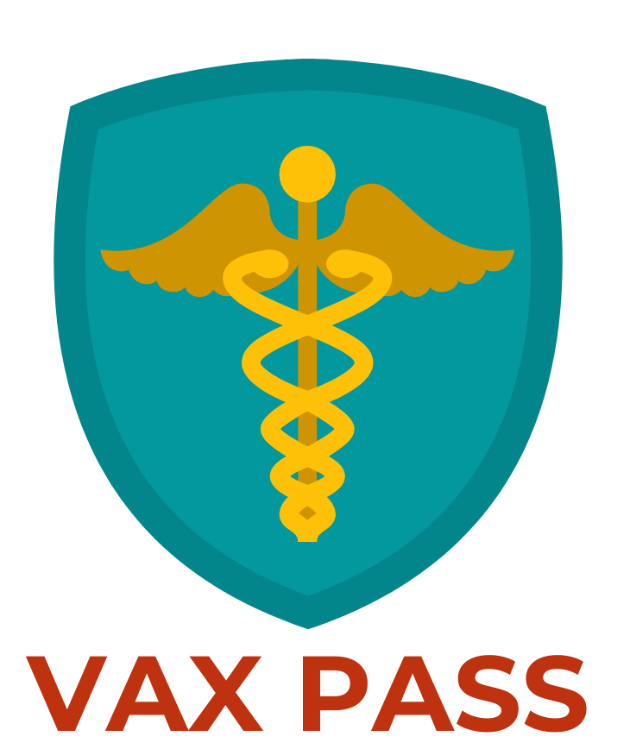

TEAM 1.04
TEAM 1.04
Notes:
SCRIPT: “Hi, my name is Emily and I’m a highschool student. I present to you Vax Pass (insert tagline if you have). This was my first Hackathon and it was a great experience to work with a diverse team on a topic that is extremely relevant to my age group. And I’ll pass it on to Nikkei to talk more about it”.
13 Seconds

Slide 2
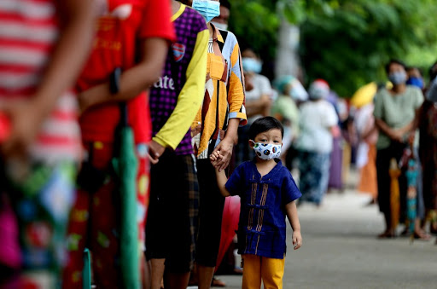
Children represented 22.4% of new [COVID] cases reported [on the week of 4/22/21-4/29/21] accounting for 71,649 out of 319,601 cases.” - American Academy of Pediatrics
TEAM 1.04
Notes:
Children represented 22.4% of new cases reported [on the week of 4/22/21-4/29/21] accounting for 71,649 out of 319,601 cases.”
12 seconds
SCRIPT:
I’m Nikkei and I work as a in-patient pediatric nurse. At the bedside, I've been seeing a rise of COVID(+) pediatric patients which is aligned with the increasing statistic of 22.4% of new cases reported by the American Academy of Pediatrics.

Slide 3


“CDC data show a 24% increase in ER mental health visits for children ages 5 to 11, compared to 2019. Among adolescents ages 12 to 17 that increase is 31%”
- Foundation of Economic Education
TEAM 1.04
Notes:
“CDC data show a 24% increase in ER mental health visits for children ages 5 to 11, compared to 2019. Among adolescents ages 12 to 17 that increase is 31%”
SCRIPT: And in addition to this, I’ve seen a SIGNIFICANT INCREASE in children struggling with eating disorders, suicidal ideation, anxiety, depression and other mental health illnesses due to quarantine & isolation which is consistent with the CDC data on increase in ER mental health visits across school aged children and teens.
, national surveys conducted in 2020 showed high percentages of teens struggling with anxiety, depression and mental health due to quarantine & isolation (from not being able to go to school and loss of social skills) which has been observed across multiple Children’s Hospitals in the US.
Workflow – Whenever I admit a patient, one of the first questions I ask the parents is “are your child’s immunizations UTD?” Often times, they don’t expect to come to the hospital with records at hand so we are relying on them to tell us the truth but how can we tell if what they are saying is FACTUAL?

Slide 4
How do we affirm that a child or young adult is current with their COVID-19 vaccination status?
*U.S. 2020 Census – 114M US population under 26
TEAM 1.04
Notes:
Hence the problem we are targeting – 6 seconds

Slide 5
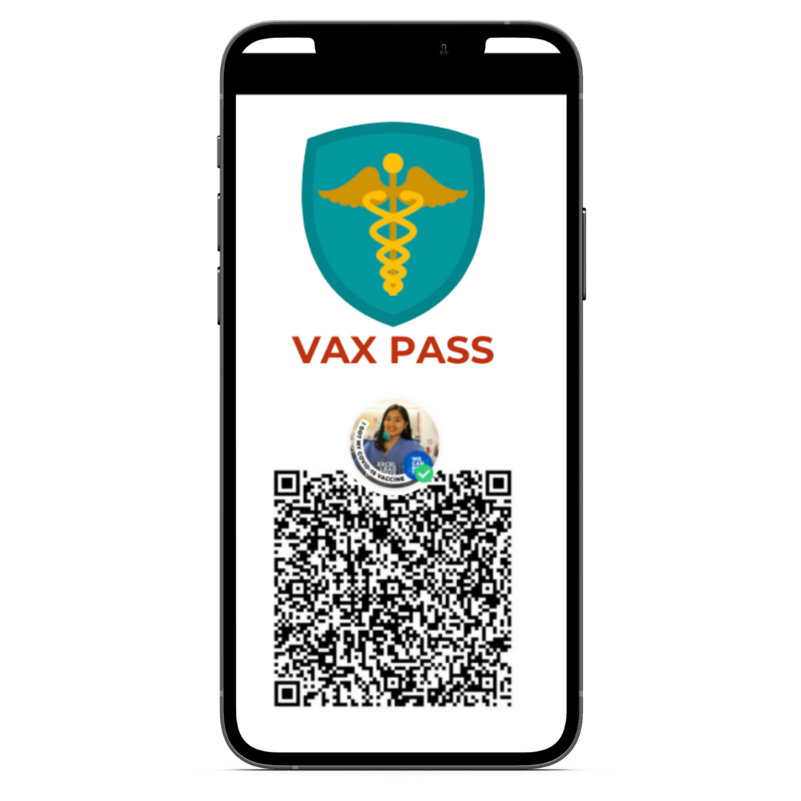

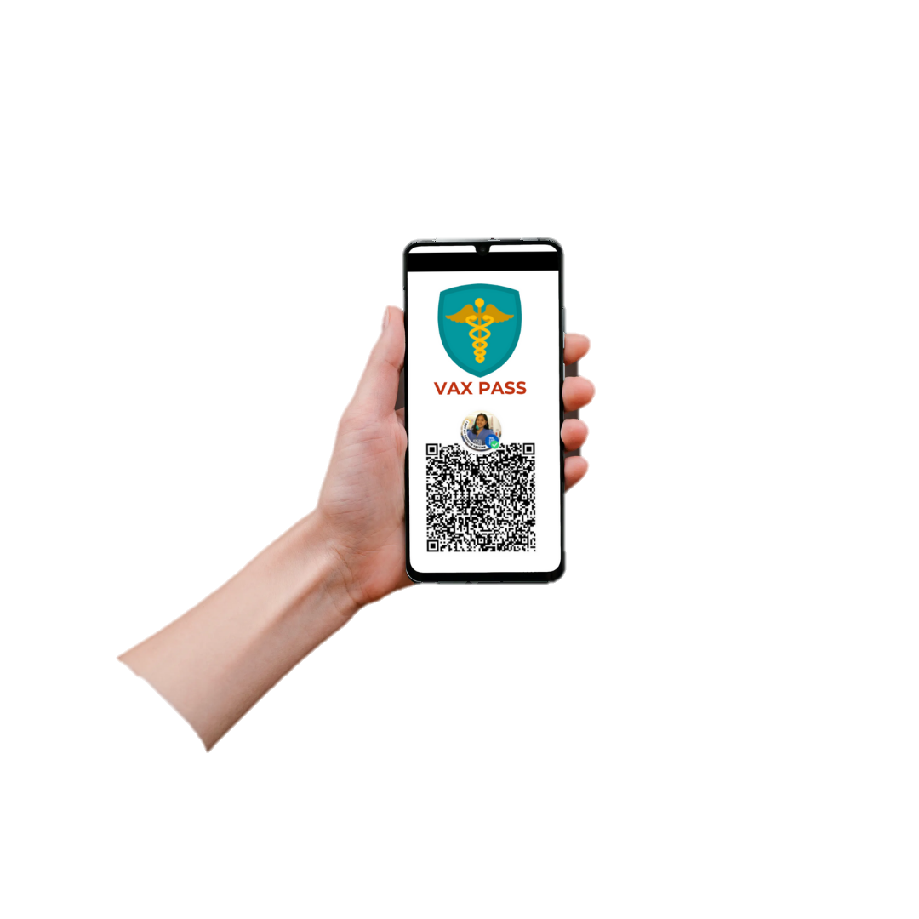
VAX Pass
MVP Features:
Cybersecurity (encryption of QR data)
Verification Authority
Data Validation
Inclusive
Audible: Soundboards
Language: Translation
Analog Solution: UID Scannable QR Pass/Key Card
TEAM 1.04
Notes:
Our VAX Pass encrypts R data and we will not be storing protected health information. The verification authority and data validation go hand in hand so that the generated QR is only readable by the app for security purposes. It includes audible and translation features for inclusivity, and we provide a QR pass similar to a credit card, as an analog solution.
Workflow: vaccination information can be filled out at the QR generator website by the vaccination facility. A QR will then be generated with information encrypted using AES-256 (symmetric encryption). The same QR will be emailed to the patient's email address (the email input area in the generator page). To verify the data, the QR scanner will then be used by the verifying facility where vaccination data is required (e.g. schools)
Data Storage and PHI: We will not be storing PGI in our own database due to regulatory complexities, to be safe. Patient’s name is already PHI – link to the QR code which contains the PHI will be sent to the patient’s email, with the added protection of encryption.
Vaccinated Frame & Digital Imprint
Cybersecurity
Defensibility
Analog: (financially excluded, underprivileged) all encompassing to for disabilities, language barriers, and financial capabilities
-------
WHO – not promoting blockchain; public key infrastructure using asymmetric encryption –
Encrypting data with private key and public key is free for anyone with verification authority; anyone can decrypt it; purpose is to make sure data is encrypted by the public key – purpose of verification
already being used by SIGNAL encrypting the data with public data so that the recipient can use their private key
QR not recommend to
Verification -
How to access data for verification? Who have already been vaccinated?
Ping the health system with a certain data – simple yes or no
.

Slide 6
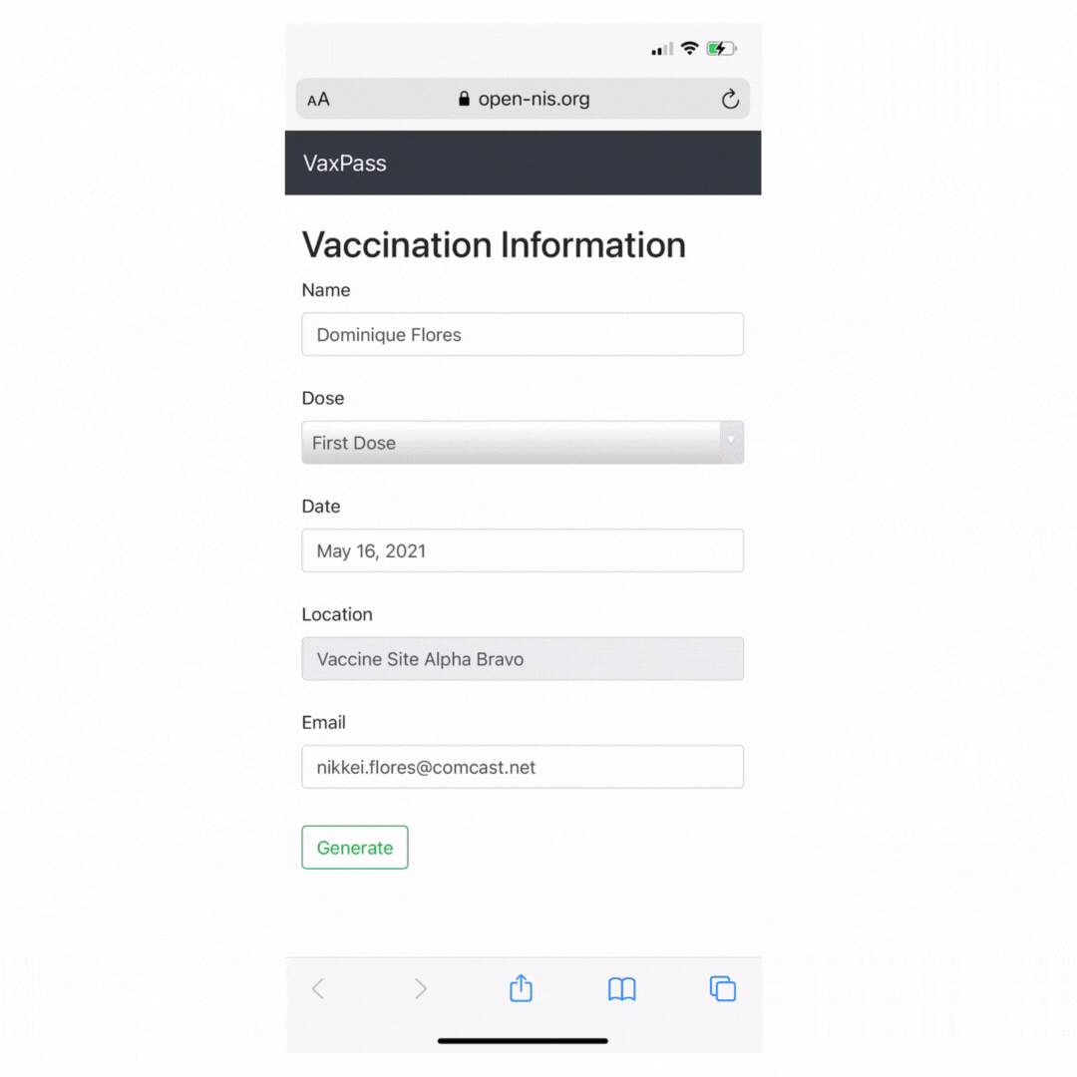
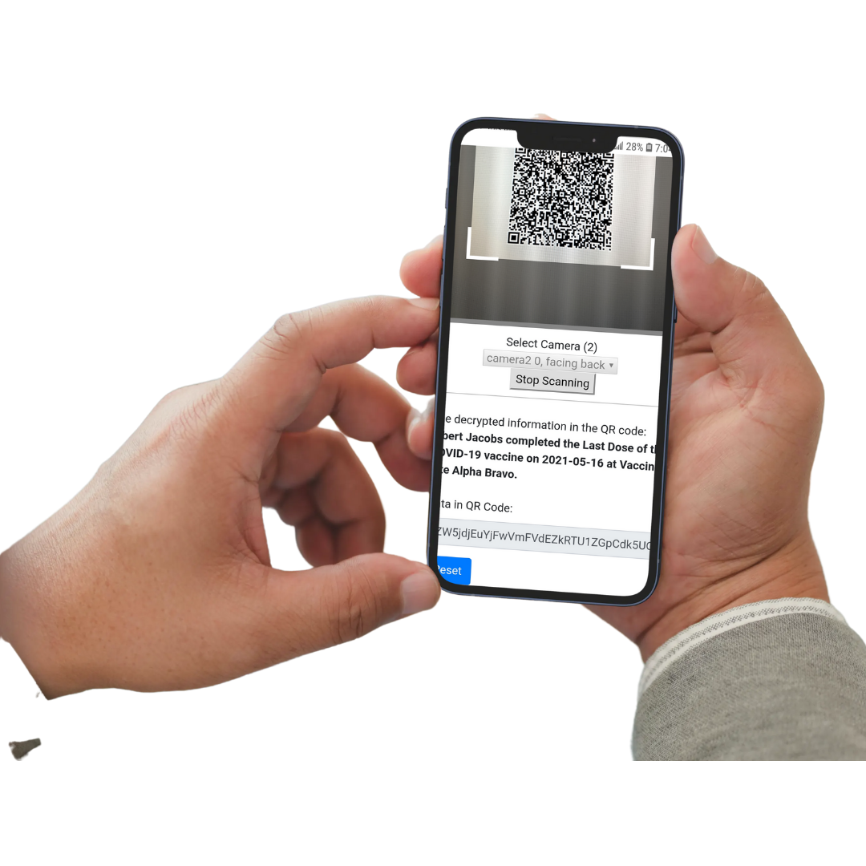
VAX Pass
For those are already vaccinated:
FHIR or HL-7 API Request for validation
For those currently getting the vaccine:
Primary Care
Pharmacy Scan Registration - Walgreens, CVS
Token Validation with Provider
TEAM 1.04
Notes:
TALKING POINTS
[For those that are vaccinated, we will use current industry {interoperability} standards to ensure {get} validation.
For those currently getting vaccinated, this will be captured at the point of care]
10 SECONDS
We have capabilities to validate those that have ALREADY been vaccinated in compliance with current industry interoperability standards, and
We also intend to capture their vaccination status at the point of the care for those that are GOING TO BE vaccinated.

Slide 7










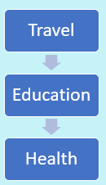
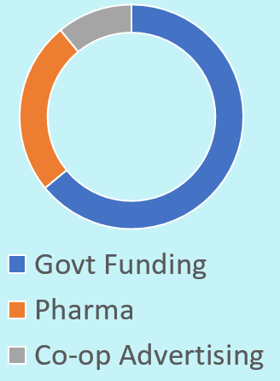
Market
TEAM 1.04
Customer
Relationships
Customer Segments
Parents
Educators
Travelers
Healthcare
Key Partners
Key Activities
Software Development
Prototype & Testing
Produce Demo
Partnerships
Product Release
Influencer and Traditional Media Marketing
Revenue
Streams
Cost Structure
Cloud server and storage
Business Development
Technical Support
Resources
Student Focus Groups
Healthcare Professionals
IT Professionals
Consumer Health
Marketing & Distribution
Channels
Notes:
Our Go-To-Market Strategy
ACQUIRING GROWTH & MONETIZATION
Value is in the network build and consumer appeal to adolescent audience (fund it through relationships with these 3 avenues)
3 Current Market Avenues
1. Providers – PCP & Hospitalists
2. Venues – Pharmacies (Walgreens, CVS), Mobile Clinics (state government-funding)
3. Places of large populated areas (that demand vaccines) – large public universities, private college institutions, sporting venues (campus football games), concerts
Lack of isolation – because you can
Appeal to Payers (Major Hospital Systems)
Lower medical cost ratio
Decrease readmissions (reimbursement issues)
Business – How to acquire customers; growth, defensibility, and security
Monetization; how do I profit? How do I benefit?
FOR PROFIT (think customer acquisition strategy) vs. NON-PROFIT (funds come from somewhere; look for partnerships)
People distributing vaccines, hospitals? – who is paying for this?
If it’s free? – who are my customers and how am I acquiring?
CUSTOMERS? – how am I getting people to download it? How am I reaching them? WOM? When they get their vaccine? Presented at point of purchase
How do you engage with them?
How much budget do you need to acquire these customers?
Where is the point of customer engagement and download?
Once you acquire them, how do you monetize?
What can you do with that data? What data are you capturing?
Who’s going to benefit from this information and data? Can you provide that data to them? How much would you charge?
B2B? D2consumer?
Where are you applying the funds? Where are you getting it to?
Lifetime of this vaccine pass? –
What is the ultimate strategy to the business? Is the strategy to grow up and sell it? EXIT Strategy?
Who would buy this? Who is the natural person you can go to?
Social Cause? Database beneficial for future pandemics.
Simplify it
Available at after 7:15PM .

Slide 8
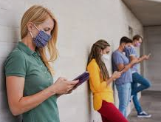
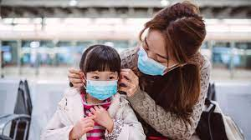
Scalability
Implementation for other vaccines
Ex: MMR, PCV, RV, Dtap
International Travel
Gamification Model for youth to engage elders (badges)
First Responder/EMS
TEAM 1.04
Notes:
The potential for growth of VAX pass can extend to include other vaccines (MMR, PCV, RV, Dtap).
Youth Leagues and Travel Teams (Sports)
This can be included for international travel driving across borders (Canada to US) or flights to other countries.
Journal of Adolescent Health: most youth in the national sample were willing to receive a COVID-19 vaccine
And by educating the youth
Youth Opinions on Vaccination for COVID19 in the USA (cohort of 14-24 y/o; 911 participants in October 2020) from Journal of Adolescent Health
Conclusion: Most youth in the national sample were willing to receive a COVID-19 vaccine when they believe it is safe and recommended. Public health experts and organizations must generate youth-centered materials that directly address their vaccination concerns.

Slide 9




Competition
Benefits​ | Our Solution​ Vax Pass | European Union Green Certificate | China Vaccine Passport | New York Excelsior Pass | Hawaii Safe Travels
Intuitive Design​ | ​ | ​ | ​ | ​ | ​
Pediatric Focus
Performance​ | ​ | ​ | ​ | ​ | ​
Quality​ | ​ | ​ | ​ | ​ | ​
Overall Assessment​ | 4 | 3​ | 2​ | 2​ | 1​
TEAM 1.04
Notes:
Source: US Census Bureau: https://www.census.gov/data/tables/2020/demo/popest/2020-demographic-analysis-tables.html
12 seconds
Mini Talking Points:
Current products out in the market are available outside of the US, namely (1-2).
Within in the US, only NY and Hawaii have a vaccine passport in progress of implementation.
None of them target children and young adults.

Slide 10

Impact
Family Expenses
Productivity Loss
Child Care Costs
Stay-At-Home Parent
Child Wellbeing
Mental Health
Return to Socialization
Community Involvement
TEAM 1.04
Notes:
The impact Vax pass will have on children and families will extend out to address productivity loss, child care costs, and eliminate the debate on being a Stay-At-Home parent (if WFH is not an option).
+47% child care costs, $3.5B allocated in CARES act, but true cost is $50 Billion, so it is woefully underfunded
There are 114M US population is under 26. With VAX Pass, we will be seeing more kids and young adults back in school and college, socializing and learn how to become part of a community, and become part of a greater cause.
26 seconds.
Mental Health: Suicidal Ideation & Eating Disorders
A June 2020 national survey of more than 1,500 teens found that:
70% of teens struggle with their mental health.
55% of teens say they have experienced anxiety.
43% of teens say that they have experienced depression.
64% of teens believe that the pandemic will take a long-lasting toll on their generation’s mental health.
Eating Disorders: We have seen roughly a 30% to 40% increase in referrals to our clinic alone," said Christine Peat, PhD, of the Center for Excellence in Eating Disorders at the University of North Carolina in Chapel Hill.
Youth Opinions on Vaccination for COVID19 in the USA (cohort of 14-24 y/o; 911 participants in October 2020) from Journal of Adolescent Health
Conclusion: Most youth in the national sample were willing to receive a COVID-19 vaccine when they believe it is safe and recommended. Public health experts and organizations must generate youth-centered materials that directly address their vaccination concerns.

Slide 11
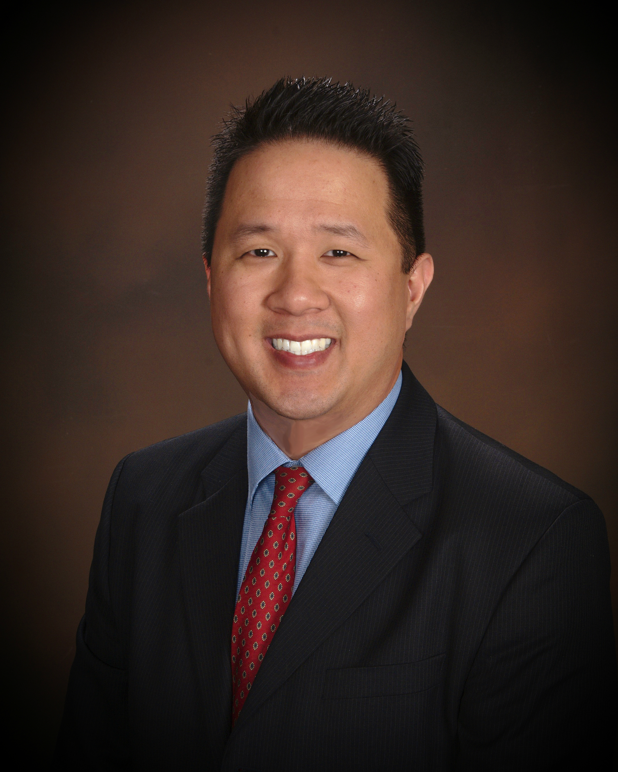




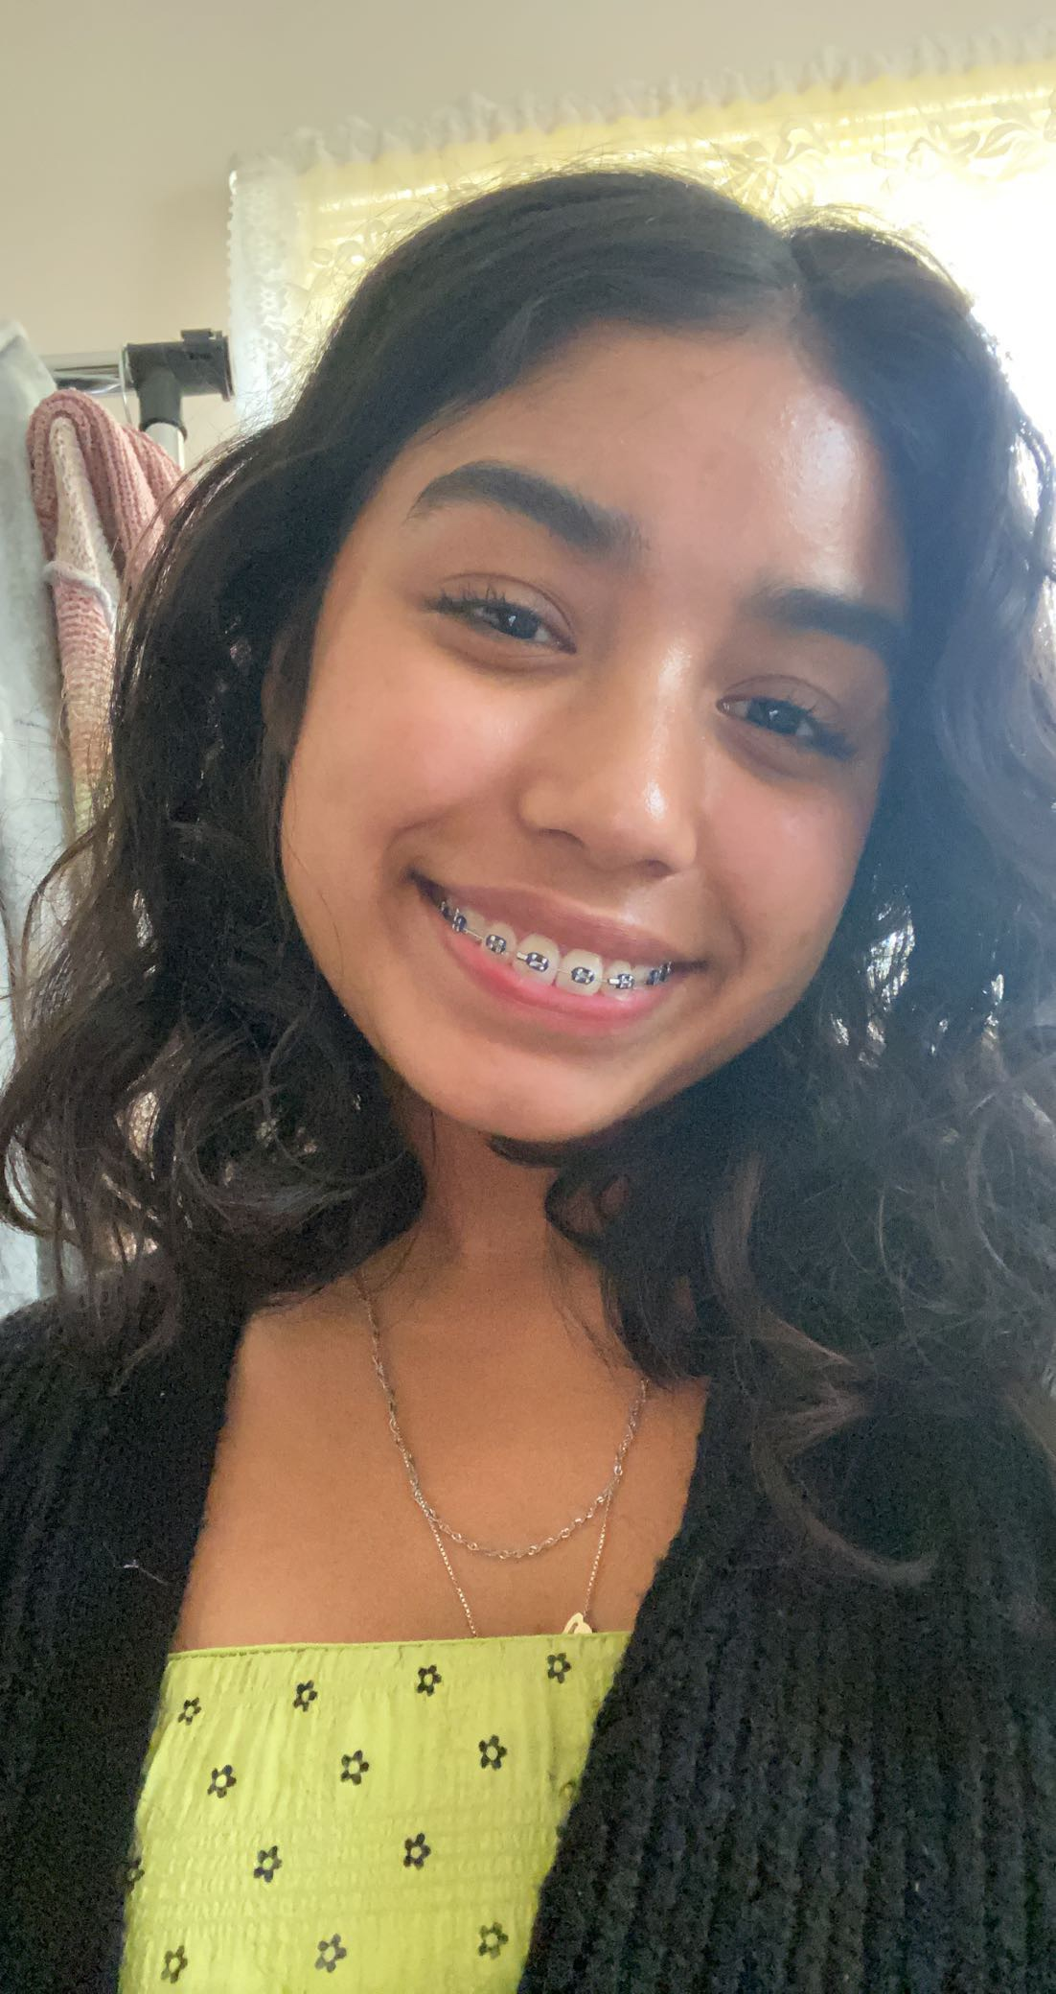


John Pan, MBA
Sr Category Insights Manager at Johnson & Johnson Consumer Health
John Barto
Health Evangelist at
Microsoft
Dominique Flores BS, RN
General Pediatric RN at
NYP-WC
Olaseeni Olayinka, BS CS CS Graduate Student at USC
Raymund John Ang MAN, RN
Travel Nurse
Tailored Healthcare Staffing
Genesis Garcia​,
High School Student
Emily Rojas Patzan​
High School Student
Jenny Romao
Pediatric/Geriatric Community Nurse
TEAM 1.04
Notes:
This is our team comprised of diverse industry professionals and students.

Slide 12
Q&A?
TEAM 1.04
Notes:
Thank you for listening and we now open the floor to any questions.

Slide 13
Appendix
TEAM 1.04
Notes:
Mental Health & Compelling Story – 30 seconds
Significance of the Problem (how does it target?) data to support
Business – How to acquire customers; growth, defensibility, and security
Monetization; how do I profit? How do I benefit?
FOR PROFIT (think customer acquisition strategy) vs. NON-PROFIT (funds come from somewhere; look for partnerships)
People distributing vaccines, hospitals? – who is paying for this?
If it’s free? – who are my customers and how am I acquiring?
CUSTOMERS? – how am I getting people to download it? How am I reaching them? WOM? When they get their vaccine? Presented at point of purchase
How do you engage with them?
How much budget do you need to acquire these customers?
Where is the point of customer engagement and download?
Once you acquire them, how do you monetize?
What can you do with that data? What data are you capturing?
Who’s going to benefit from this information and data? Can you provide that data to them? How much would you charge?
B2B? D2consumer?
Where are you applying the funds? Where are you getting it to?
Lifetime of this vaccine pass? –
What is the ultimate strategy to the business? Is the strategy to grow up and sell it? EXIT Strategy?
Who would buy this? Who is the natural person you can go to?
Social Cause? Database beneficial for future pandemics.
Simplify it
Available at after 7:15PM .

Slide 14
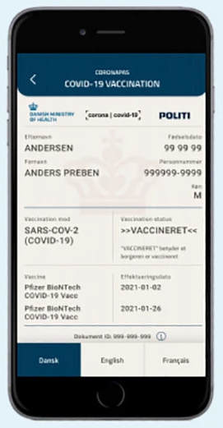
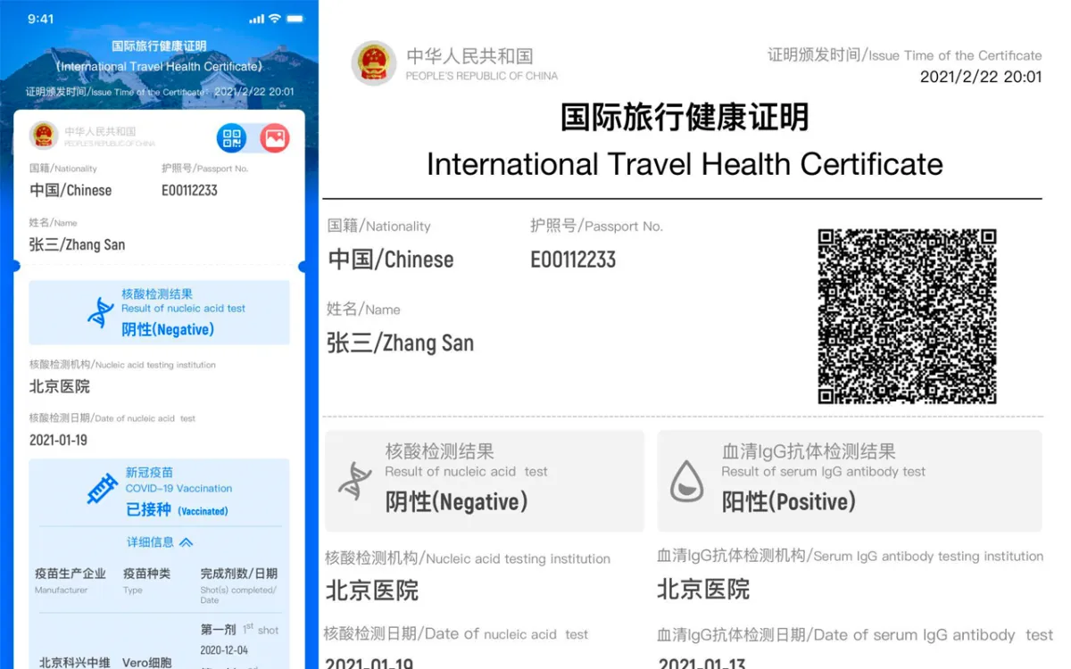
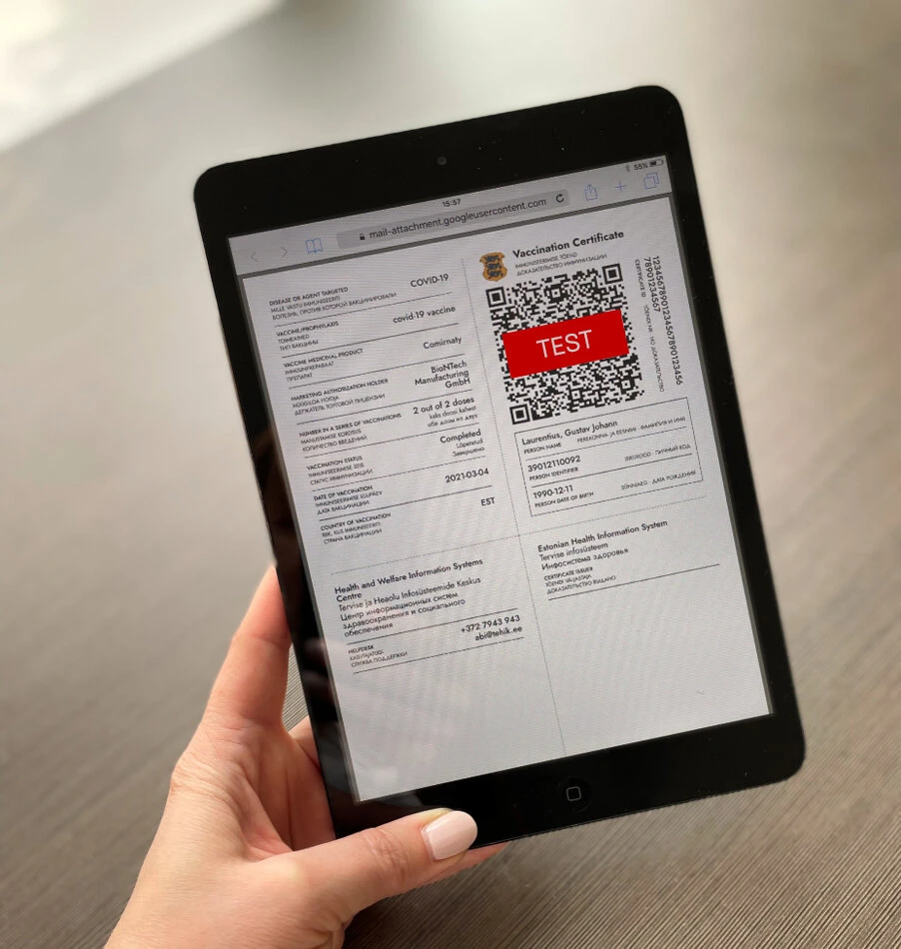
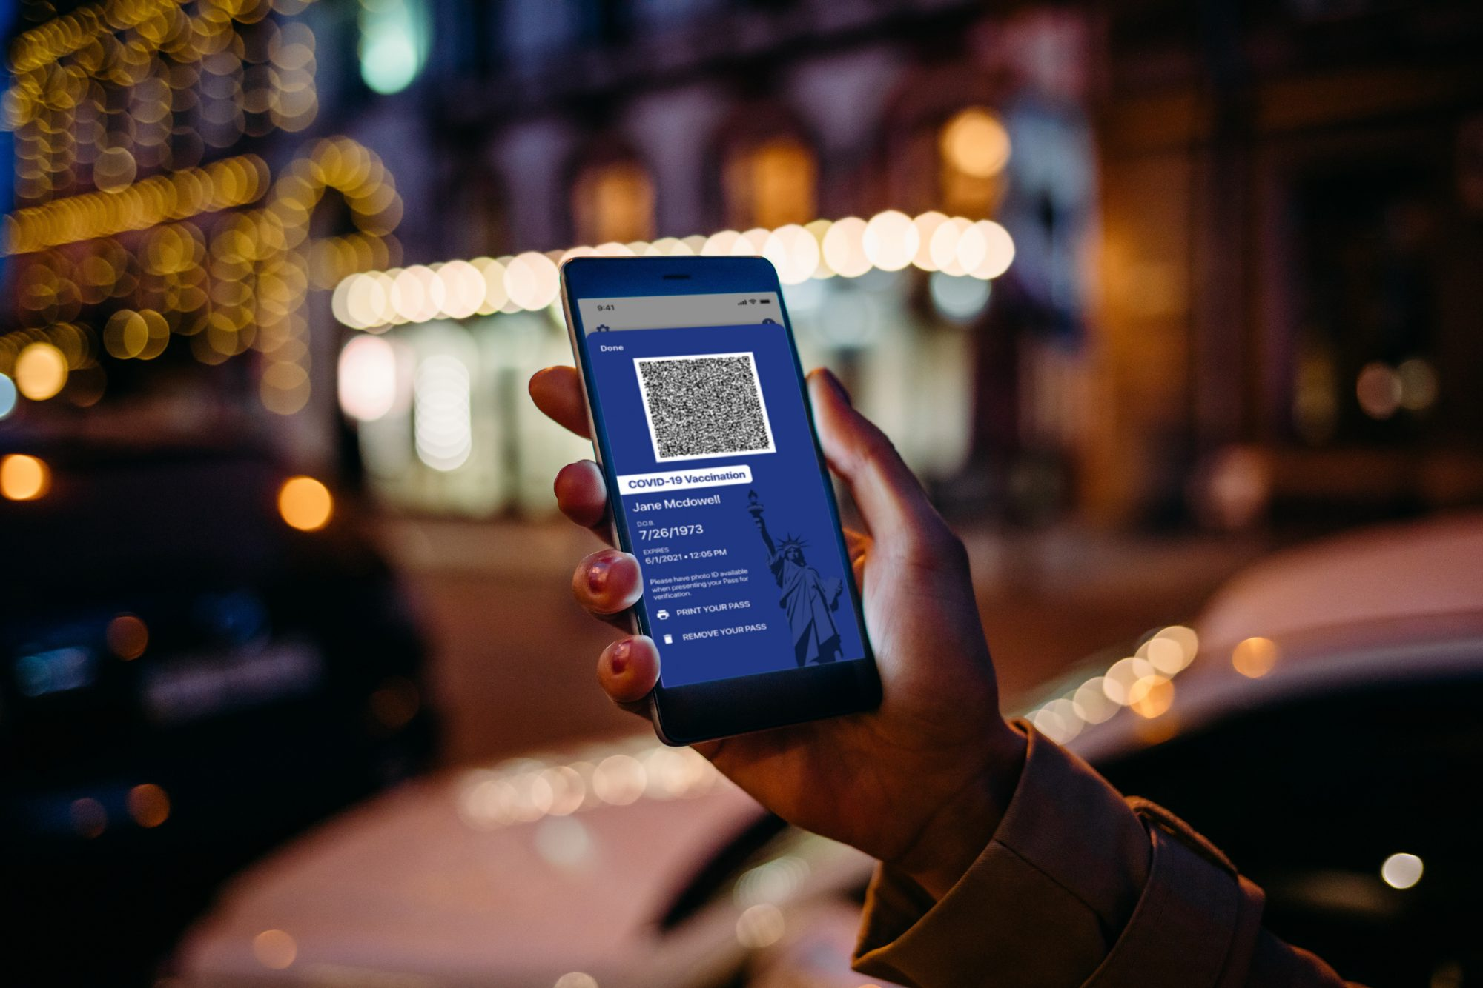
Competition
Flags of Countries + Images of Vaccine Passport
USA:
NY/HI, Europe / Asia –
International:
European Union – Green Certificate
China – Vaccination Passport
Denmark – Coronapas
Estonia – VaccineGuard
Israel – Green Pass
Panama – Travel Pass
Hawaii – Safe Travel, Clear's Health Pass, CommonPass
New York – Excelsior Pass
International – IATA Travel Pass App
TEAM 1.04
Notes:
Source: US Census Bureau: https://www.census.gov/data/tables/2020/demo/popest/2020-demographic-analysis-tables.html
Mini Talking Points:
Current products out in the market are available outside of the US, namely (1-2).
Within in the US, only NY and Hawaii have a vaccine passport in progress of implementation.
None of them target children and young adults.

